Slide 1
Golden Valley
Lions

Slide 2
What is PBIS?
Positive Behavioral Interventions
and Supports
PBIS is a positive, proactive approach to encouraging and acknowledging expected behaviors within the school. The PBIS initiative
is an on-going process that will continue to develop in the months and years to come. We make decisions based on the needs of our students and our school

Slide 3
PBIS is not a curriculum - it is a framework for systems to identify needs, develop strategies, and evaluate practice toward success

Slide 4
PBIS Lion Overview
•This PowerPoint reviews the following critical elements of Tier 1, Tier 2, and Tier 3 PBIS Implementation:
School-Wide Systems for Student Success (RTI Model)
Effective Procedures for Dealing with Discipline
Alternatives to Discipline
Selecting and Making School-Wide Expectations Visible
Teaching School-Wide Expectations to Students and Staff
A School Wide Incentive System for students and staff
Active Supervision and Positive Reinforcement Ratio (supports behavior goal)
Faculty Commitment
Examples of Promoting Communication with Parents
Examples of Promoting Positive Behavior in the classroom.

Slide 5
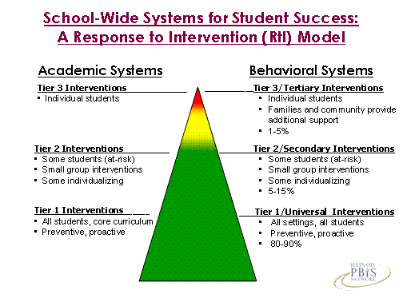

Slide 6
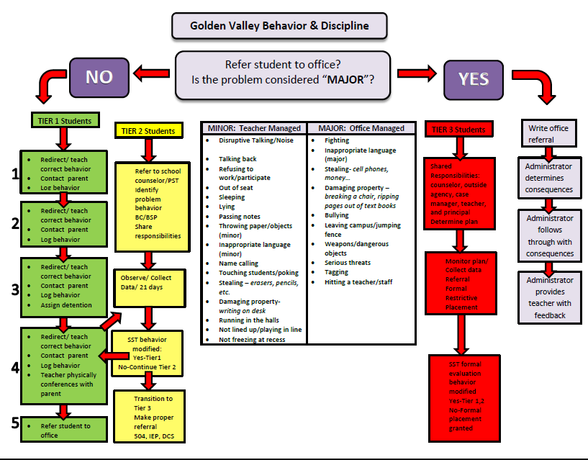

Slide 7
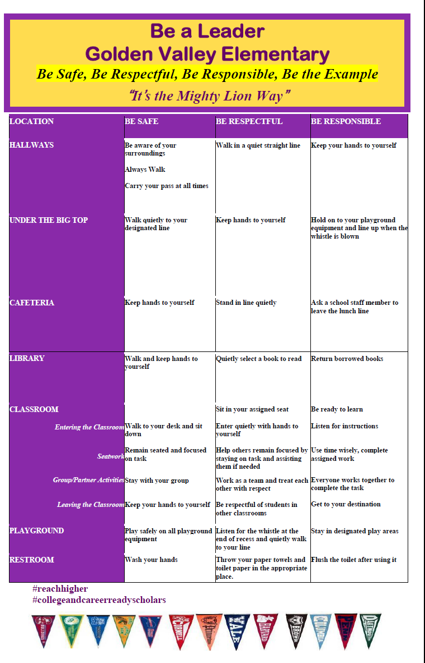
PBIS Lion Expectations
“It’s the Mighty Lion Way”
Golden Valley Expectations posters are displayed throughout campus. How many Posters can you find?

Slide 8
How do we implement PBIS?
We identify common areas where clear
expectations are needed using school
collected data.
We establish a set of teachable expectations for all students, faculty and staff using a common language for each area.
We teach, practice, and positively reinforce these expectations.
We encourage all students by looking for the positives and providing immediate, frequent, and detailed feedback.

Slide 9
Where will we begin our PBIS focus?
We have been using principles and concepts of PBIS within the classroom. These are our initial areas of focus, but we are committed to using PBIS school wide.
Restrooms
Playground/Recess
Cafeteria
Hallways
Library
Computer Lab
Office

Slide 10
How is Golden Valley School using PBIS?

Slide 11
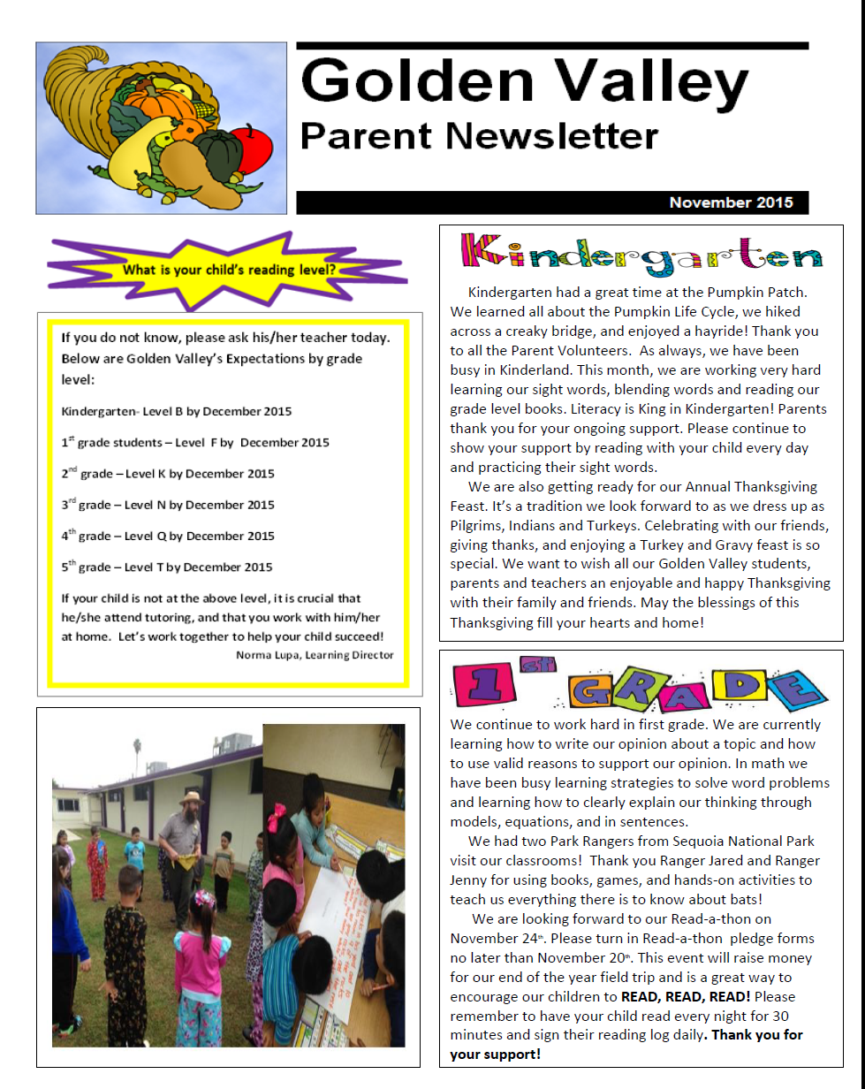
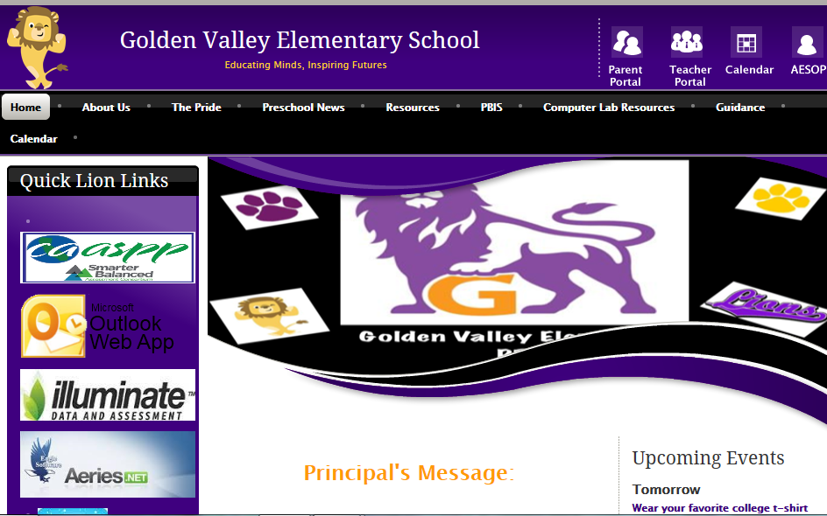
Tier 1
Golden Valley Website
Parent Newsletters

Slide 12
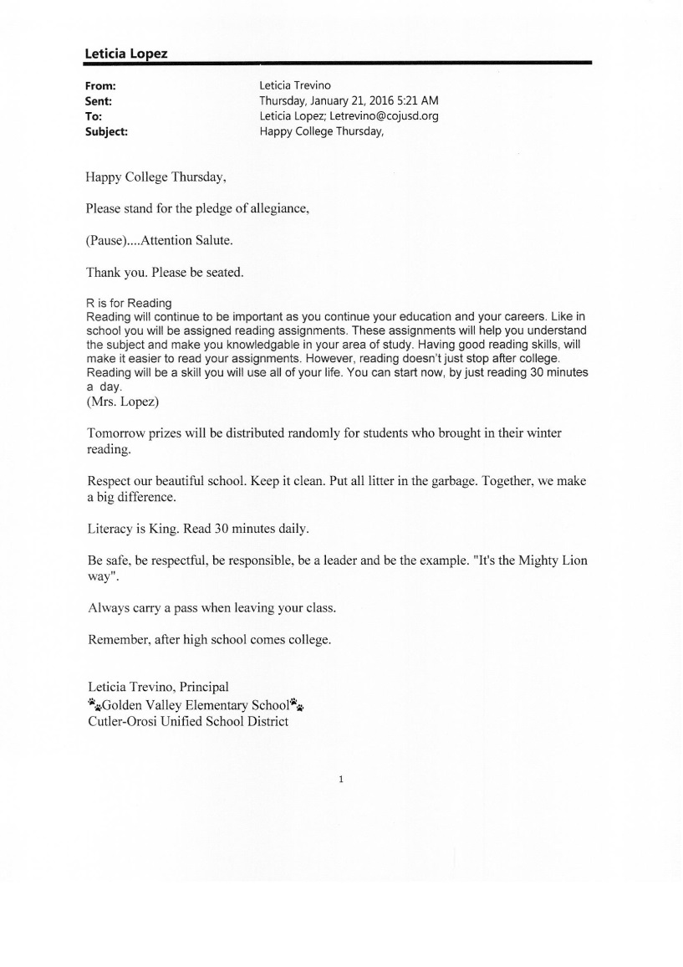
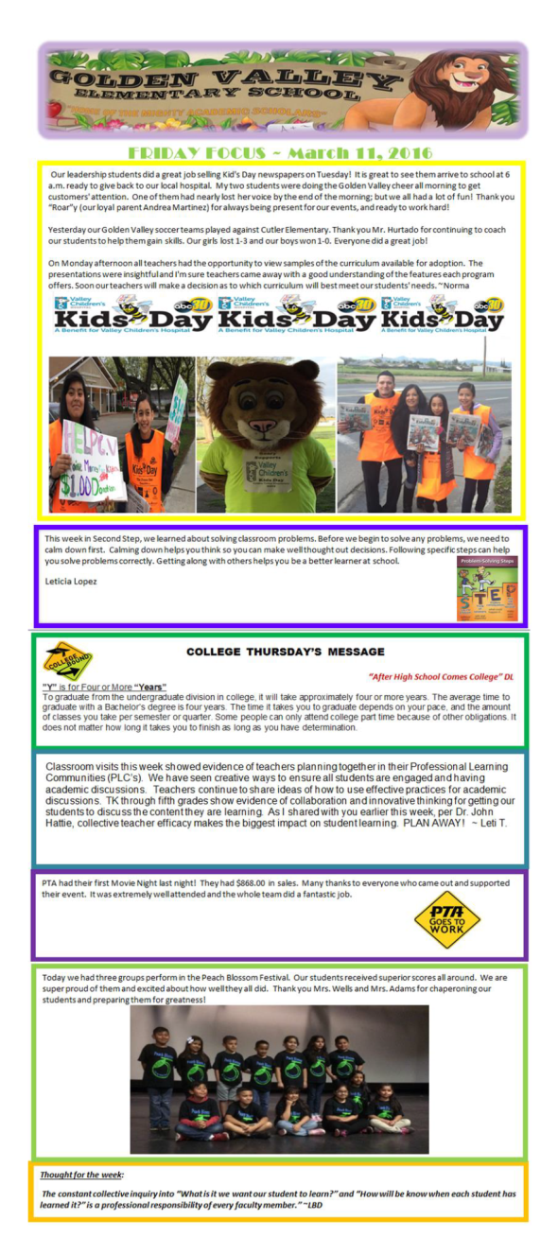
Tier 1
Daily Morning Announcements
Friday Focus

Slide 13
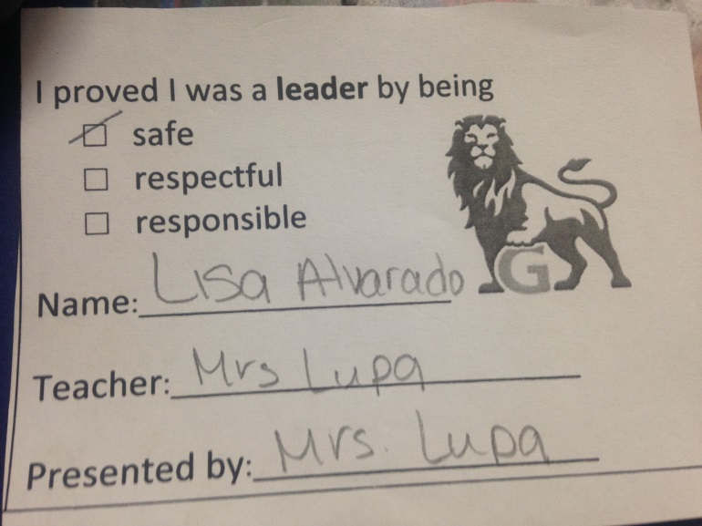
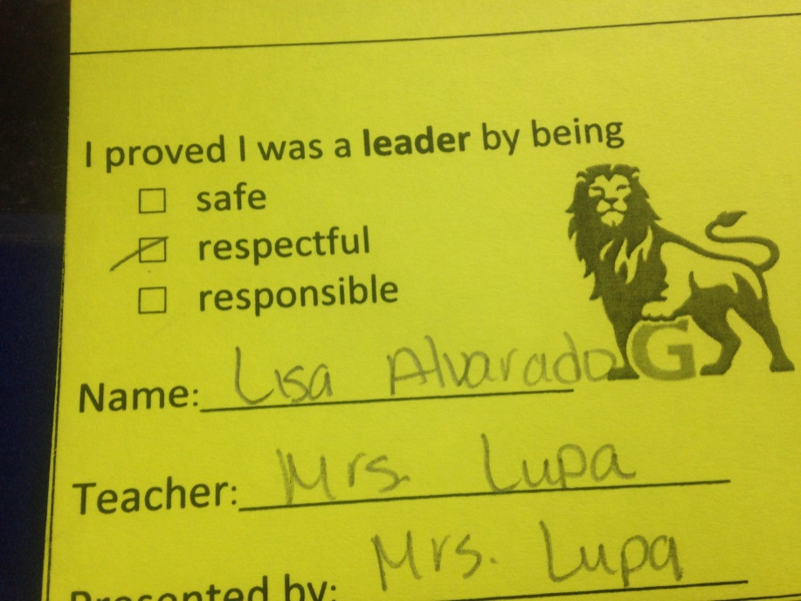
PBIS PAWSOME TICKETS
White tickets are given by teachers. After 20-30 tickets (depending on grades) the students are awarded pins for their lanyards
Yellow Tickets are placed in a drawing every Friday for a chance to win popcorn

Slide 14
lions Parent Monthly Calendars
Lion Staff Weekly Bulletin

Slide 15
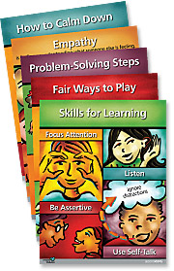
Tier 2
Second Step
Second Step program is a 22 week session program designed to teach children how to understand and manage their emotions, control their reactions, be aware of others’ feelings, and have the skills to problem-solve and make responsible decisions. Each lesson consists of a Warm up, Introduction, Story and Discussion, Skill Practice and Wrap up. Second step is broken down into four units of learning consisting of Skills for Learning, Empathy, Emotion Management, and Problem Solving.

Slide 16
Lion Check In - Check Out
Improved structure
Prompts are provided throughout the day for correct behavior.
System for linking student with at least one positive adult.
Student chooses to participate.
Student is “set up for success”
First contact each morning is positive.
“Blow-out” days are pre-empted.
First contact each class period (or activity period) is positive, and sets up successful behavioral momentum.
Increase in contingent feedback
Feedback occurs more often.
Feedback is tied to student behavior.
Inappropriate behavior is less likely to be ignored or rewarded.
Program can be applied in all school location
Classroom, playground, cafeteria (anywhere there is a supervisor)
Elevated reward for appropriate behavior
Adult and peer attention delivered each target period
Adult attention (and tangible) delivered at end of day
Linking behavior support and academic support
For academic-based, escape-maintained problem behavior incorporate academic support
Linking school and home support
Provide format for positive student/parent contact
Program is organized to morph into a self-management system
Increased options for making choices
Increased ability to self-monitor performance/progress
Name: _______________ Date:____ PBIS Daily Progress Report
RESPECT others (no interruptions)
FOCUS on completing classwork
BLOCK 1 ELA Reading Groups | 1 2 3 1 2 3 (circle one) Signature
BLOCK 2 MATH | 1 2 3 (circle one) Signature
BLOCK 2 (after lunch) | 1 2 3 (circle one) Signature
ELD | 1 2 3 (circle one) Signature
EARN 2’s and 3’s ALL day to earn a reward!
(1’s will disqualify you from a reward)

Slide 17
Peer Mediation
Peer Mediators are trained in explicit speaking and listening skills. Peer mediators assist helping their peers resolve their issues in a peaceful problems solving manner.

Slide 18
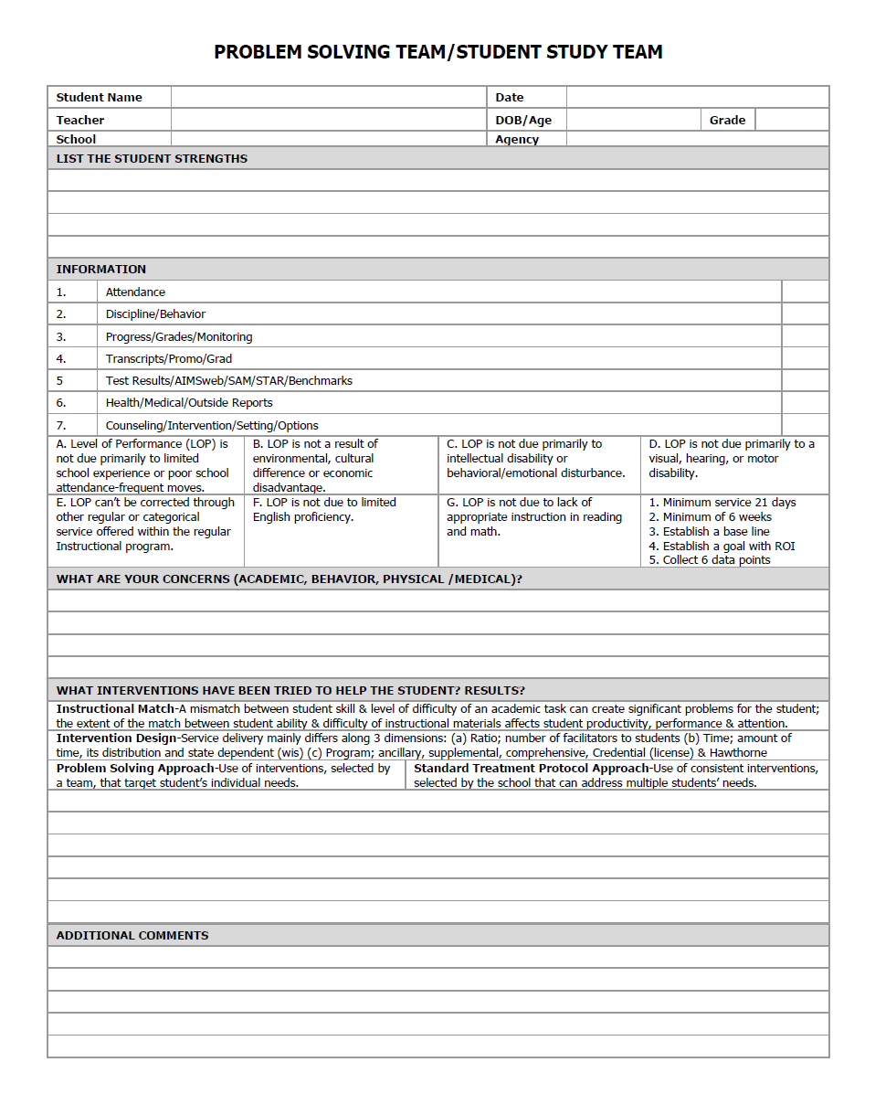
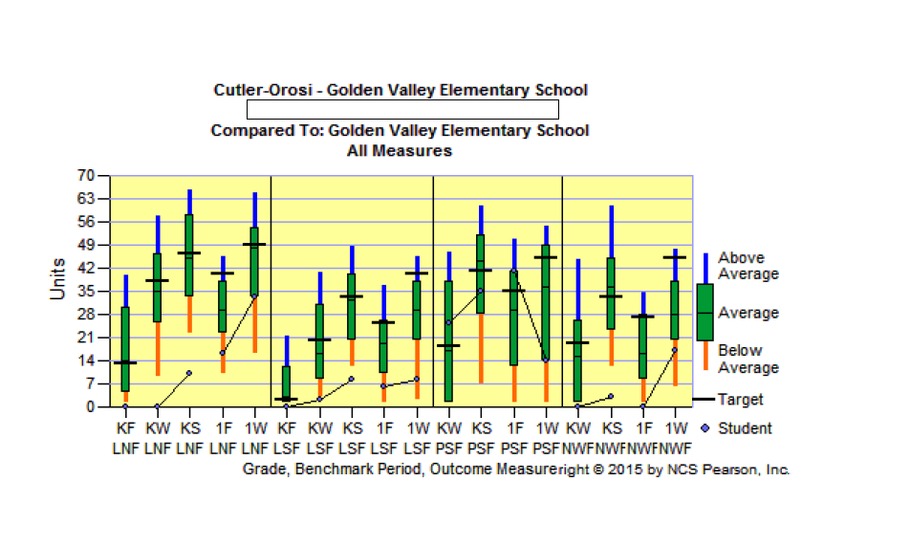
SST Meetings
The SST is a group formed within the school to further examine a student’s academic, behavioral and social-emotional progress. The SST team can propose interventions for the student. The team usually consists of a teacher, administrator, and support personnel from the school. SST’s are followed every 6-8 weeks to progress monitor student.
Aims Web (curriculum-based measurement) is used for universal screening and progress monitoring of students. Each student has their own goals and are progress monitored for 6-8 weeks or throughout the semester.

Slide 19
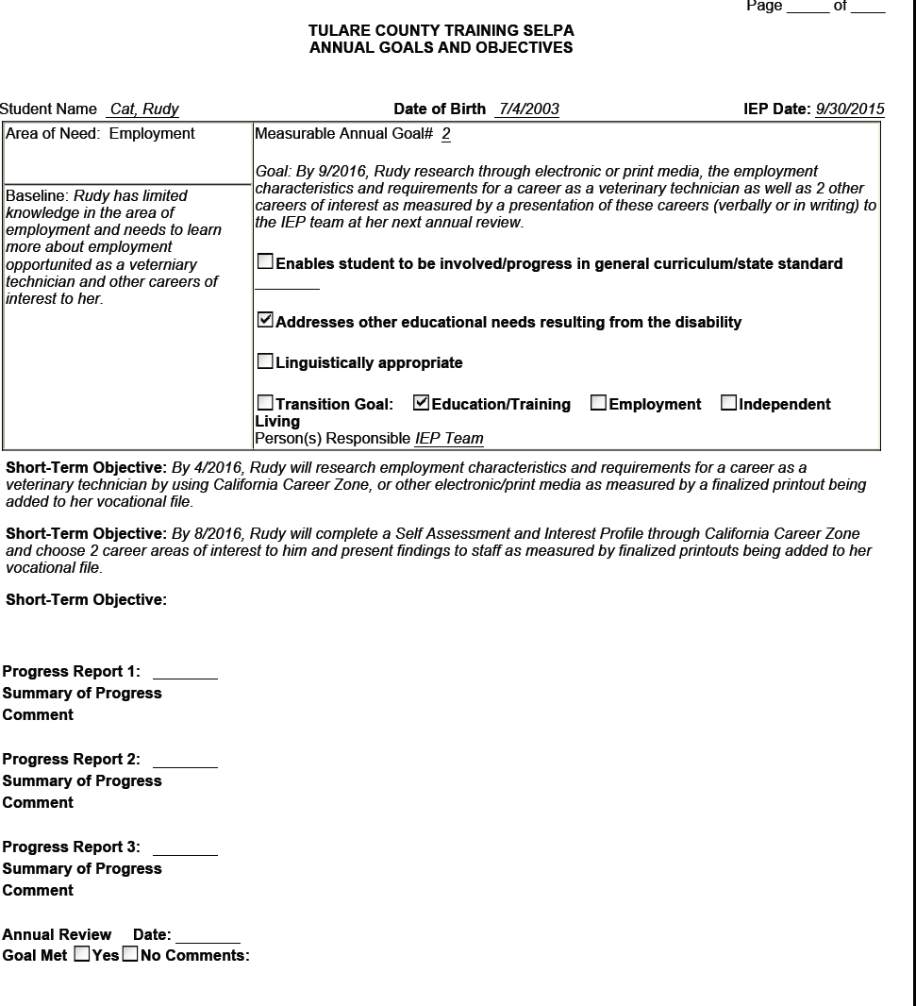
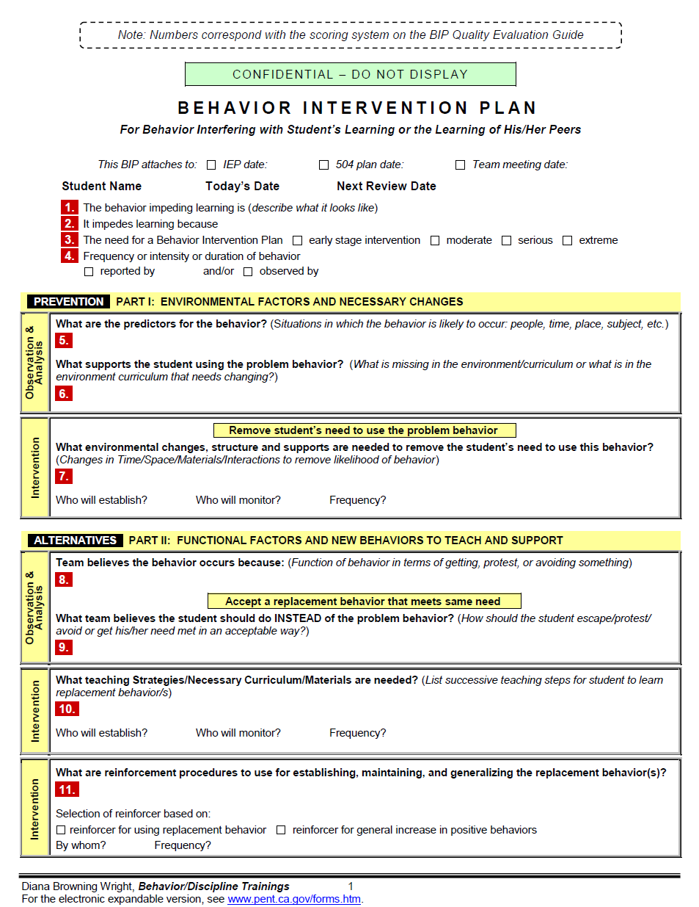
Tier 3
IEP
SST
BSP
IEP: Short for Individualized Education Program, an IEP is the legal document that defines a child's special education program. An IEP includes the disability under which the child qualifies for Special Education Services (also known as his classification), the services the team has determined the school will provide, his yearly goals and objectives and any accommodations that must be made to assist his learning.
The SST is a group formed within the school to further examine a student’s academic, behavioral and social-emotional progress. The SST team can propose interventions for the student. The team usually consists of a teacher, administrator, and support personnel from the school.
Behavior Support Plans (BSP) are behavior plans for those students who need more intensive behavioral services.

Slide 20
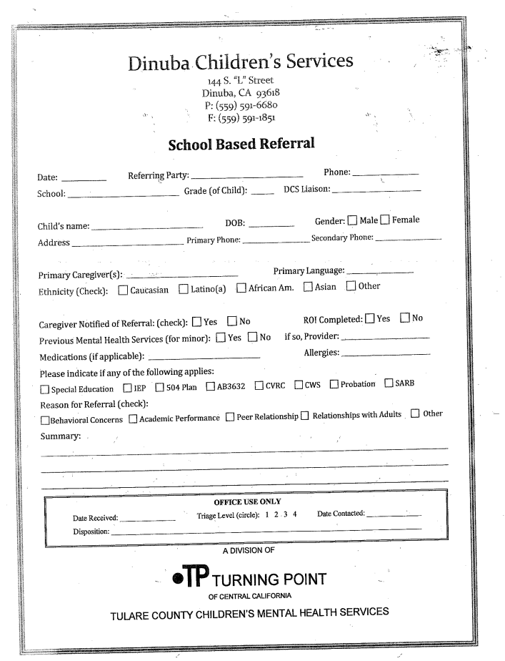
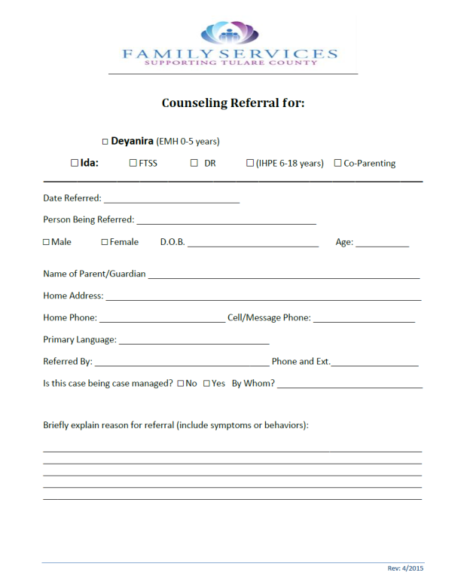
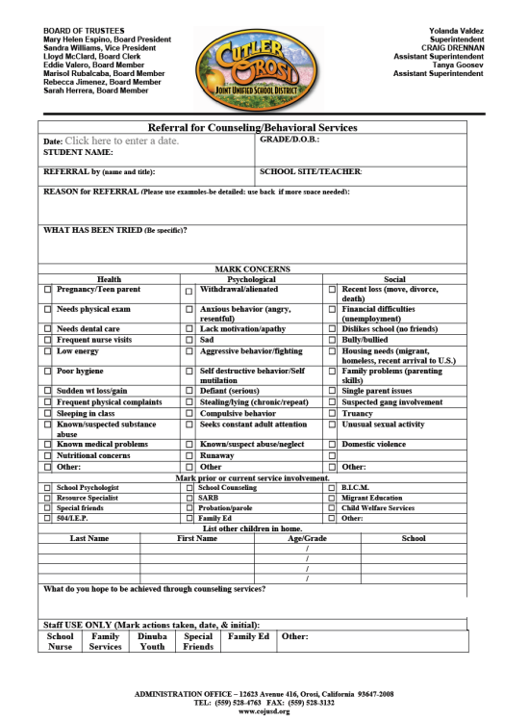
Outside resources such as Mental health services or Family Ed Center

Slide 21
Ongoing PBIS Staff Training

Slide 22
PBIS Staff Survey Results
1. What does PBIS stand for? | a. Peanut butter is sweet =0 | b. positive behavior intervention supports=26 | c. Proactive Behavior Intervention strategies=3
2. How many levels of PBIS are there? | a. 1=0 | b. 2=0 | c. 3= 29
3. What is PBIS? | a. Framework= 26 | b. curriculum= 1 | no answer=2

Slide 23
4. What are Pawsome tickets given for?
Rewards to students for good behavior/behavior (11), Reinforce PBIS (2), Responsibility & respect, Being safe, respectful, sign of a leader (3), Positive behavior, Exceptional behavior, Great examples to follow, Great accomplishment in area of PBIS, Positive behavior that complies with PBIS grid, Positive behavior(2), Good behavior-caught doing good deed, Acknowledging and reinforcing positive behavior.
5. What colors are Pawsome Tickets? | White/yellow (21), Yellowish Green, yellow/green (1), Gold/White (2), Yellow (2), White/Green, White/Greenish Yellow,

Slide 24
6. What are Golden Valley's School-wide expectations?- correct answer is "be safe, be respectful, be responsible, be the example"
Staff response: Student safety, be safe, be responsible, be a leader,/be the example, be responsible be safe, be respectful be a leader/all students will be reading at level/respect, responsible, safe, leader/high reading and writing expectations. We are trying to get all students at grade level/walking in lines, using restroom at recess being respectful and responsively and trying your best/be safe, be the example, be respectful etc./being safe, respectful, responsible a leader/for all students to be leaders/positive behavior for being responsible, respectful safe and a good leader/being safe, responsible, being a leader being the example(2)/be respectful, safe , be responsible/positive interactions, positive choices, literacy is king/what's on everyone's wall/ be responsible, be a leader, be the example, be respectful/be safe, be respectful, be responsible and be a leader/to be safe, responsible, leader and example/safe, respectful, responsible, example/be a leader, be an example/all students will learn , literacy is king, be safe, be respectful, be responsible, be the example to follow/all students will learn/be safe, be respectful, be a leader, be responsible/be respectful, be responsible, be a leader, be the example/be a leader, be safe, be responsible, be the example/be safe, be respectful, be responsible/every student will be college ready/be safe, be respectful, be responsible, and be the example, it's the mighty lion way/be safe, respectful, responsible, be a leader/

Slide 25
7. What are some ways you promote communication with parents?
Weekly behavior charts that require parents signature (3), parent night, newsletters (5), parking lot , speak with parents, highlight news, weekly reports home on bx and curriculum, progress reports, contact inform exchange, class dojo, email, text (2), day to day communication, written notes (formal and informal), programs, workshops, notes home (10), daily greeting, talking to parents in a positive manner, behavior charts (2), literacy nights, ieps, communication, send out flyers, phone calls (9), speaking to parents after school (2), family parent nights, personal contact, homework logs, report cards, conferences (5), weekly notes, reading log homework and behavior, parent meetings, orally, written, through the children, homework checklists
8. What are some ways you promote positive behavior in your class? Rewards for positive behaviors, pawsome tickets (16), teachers pink tickets, praise (8), bx chart, points, rewards (9), model bx(3), chips, point system for good bx, incentives, mutual respect, prizes, discussion with students about positive bx. role model and how we are a community of learners, expectations, use student as models and behaviors, whoever shows all positive bx gets more time, sing the positive bx, celebrate with cheers, celebrate pin winners, raffle tickets, going over rules, encouraging good bx, sticker charts(3), table prizes, tangible rewards, positive bx in my classroom, bean jars (2), treasure chest (2), praise note some, PBIS rubric, bx tickets, behavior chart, group points(5), class encouragers, gold fish as rewards, management skills, acknowledgement,
Extra Credit! What is Golden Valley's current PBIS Level and what is our Goal?- Correct answer is Bronze/Gold
Bronze/? (7)
Bronze/Gold (3)
Silver/Gold (7)
silver/? (2)
one, three
level 3 for students to be leaders
reach the gold
/Gold (6)

Slide 26
Thank you from the PBIS Team!!!

